Slide 1

Notes:
Slide 0

Slide 2
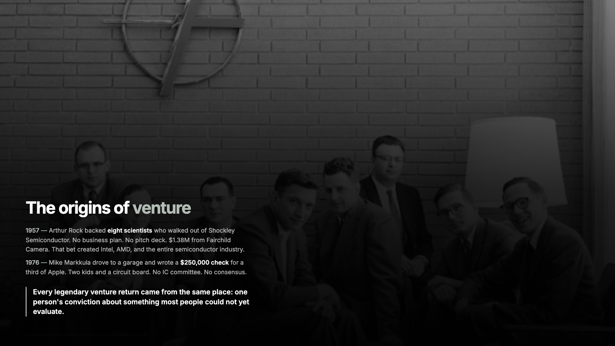
The origins of venture
Notes:
Slide 1

Slide 3
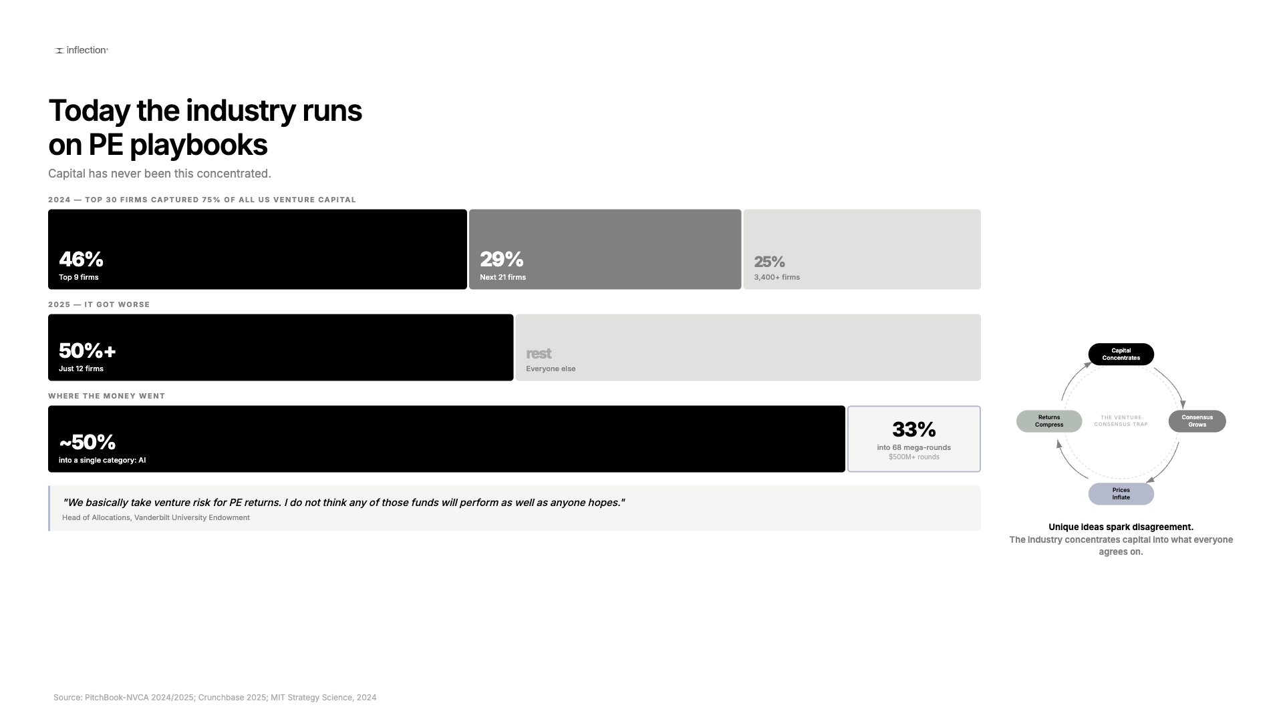
Today the industry runs on PE playbooks
Notes:
Slide 2

Slide 4
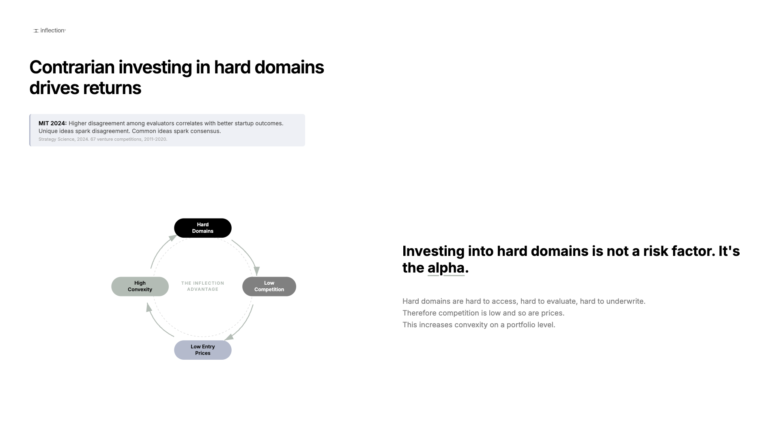
Contrarian investing in hard domains drives returns
Notes:
Slide 3

Slide 5
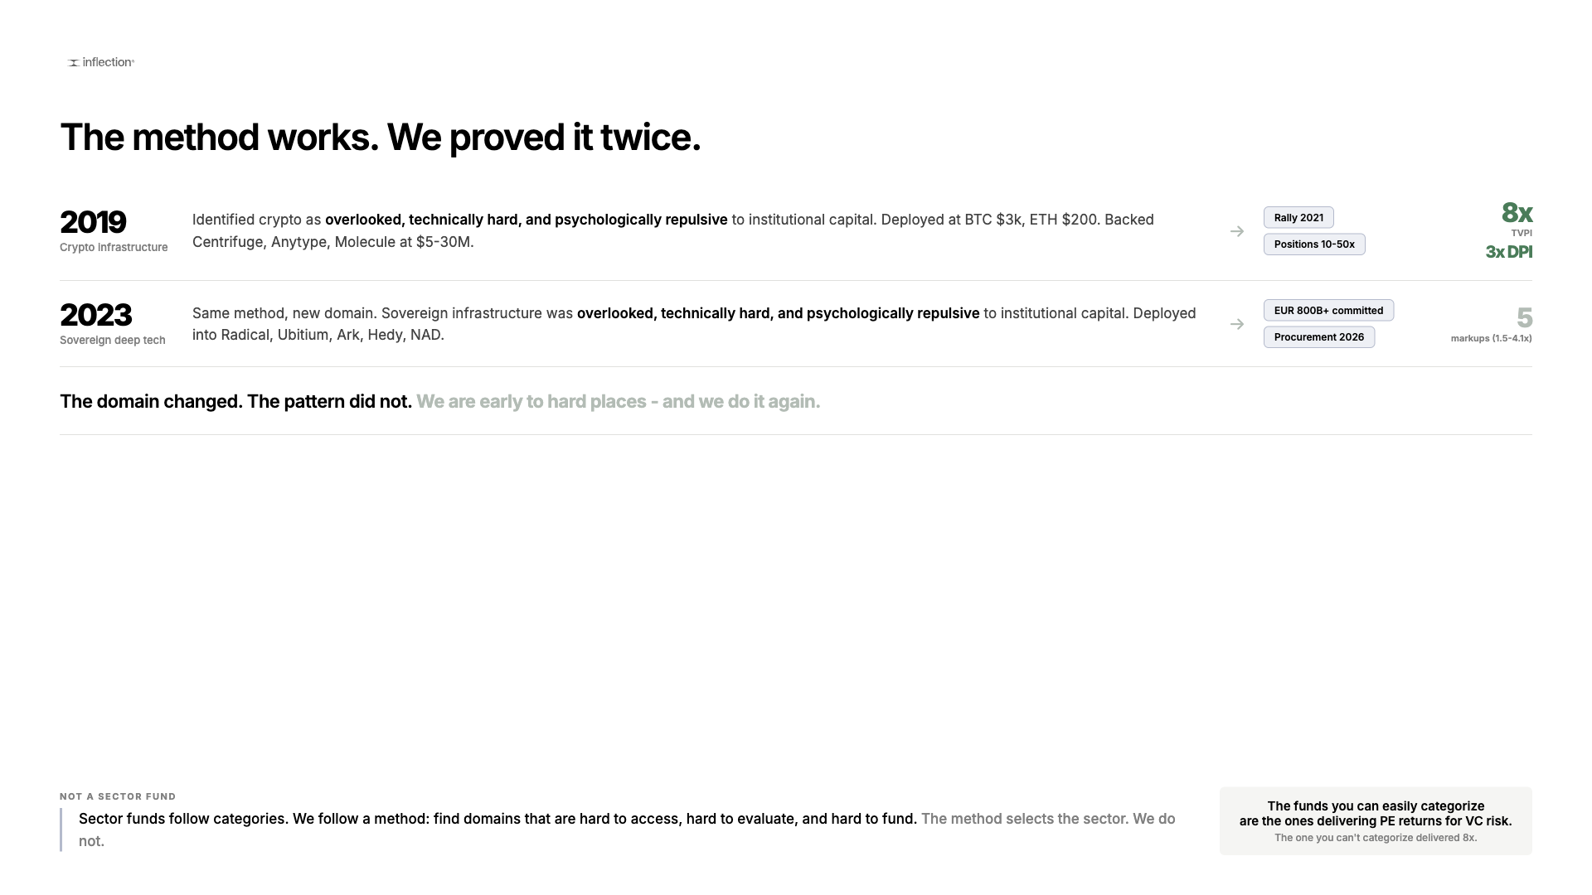
The method works. We proved it twice.
Notes:
Slide 4

Slide 6
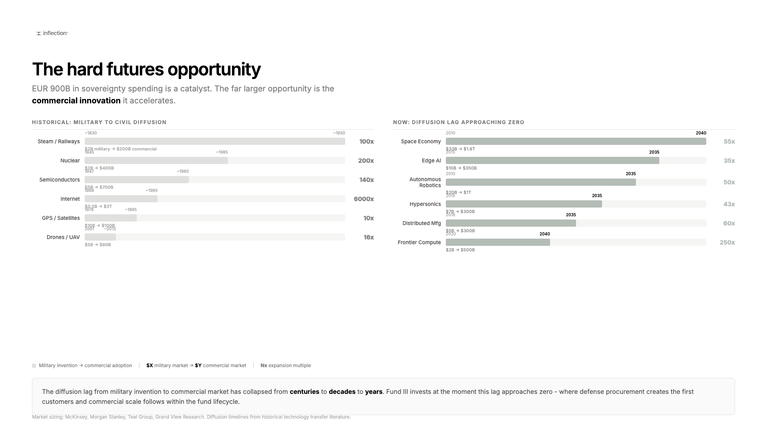
The hard futures opportunity
Notes:
Slide 5

Slide 7
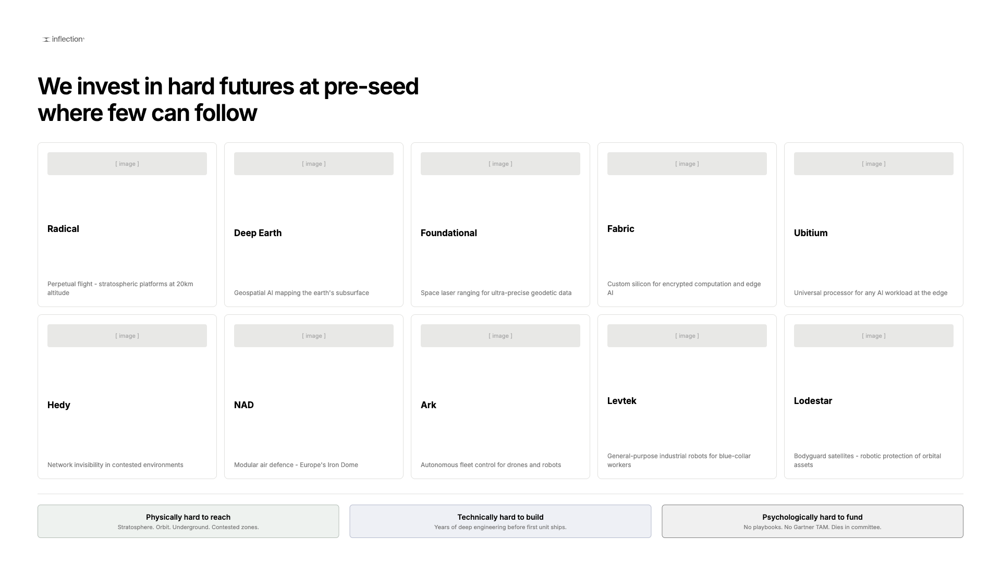
We invest in hard futures at pre-seed where few can follow
Notes:
Slide 6

Slide 8
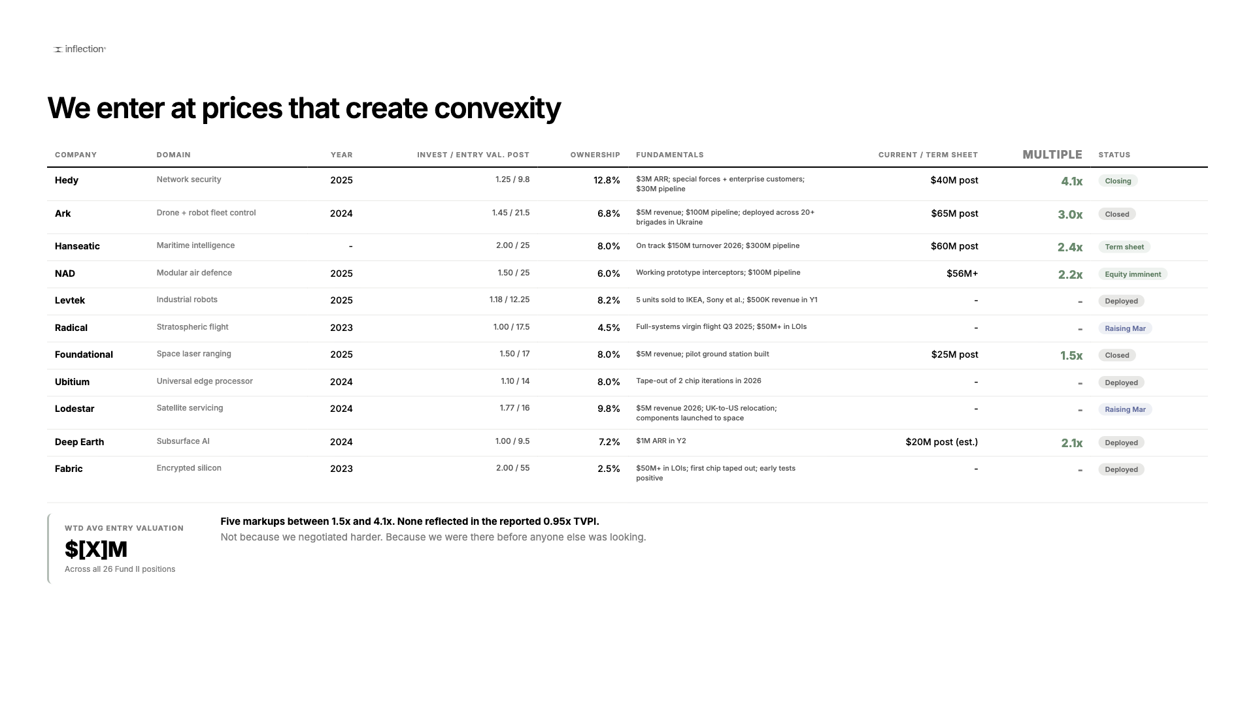
We enter at prices that create convexity
Notes:
Slide 7

Slide 9
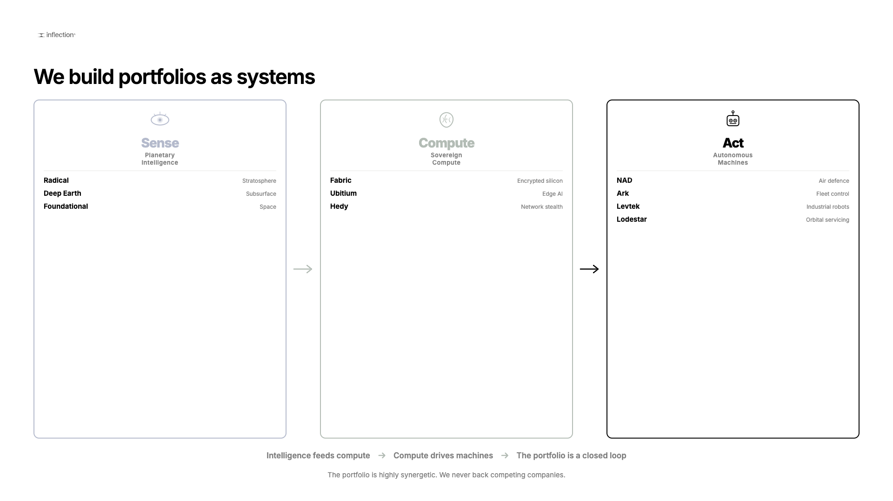
We build portfolios as systems
Notes:
Slide 8

Slide 10
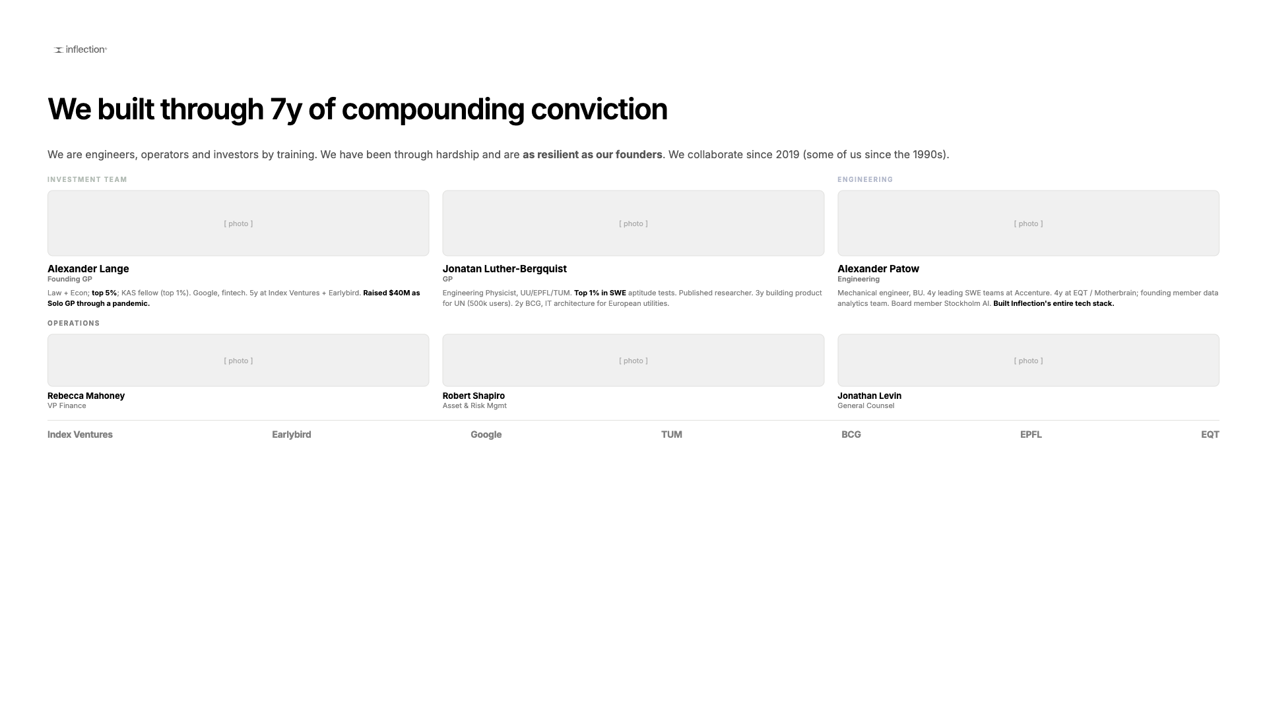
We built through 7y of compounding conviction
Notes:
Slide 9

Slide 11
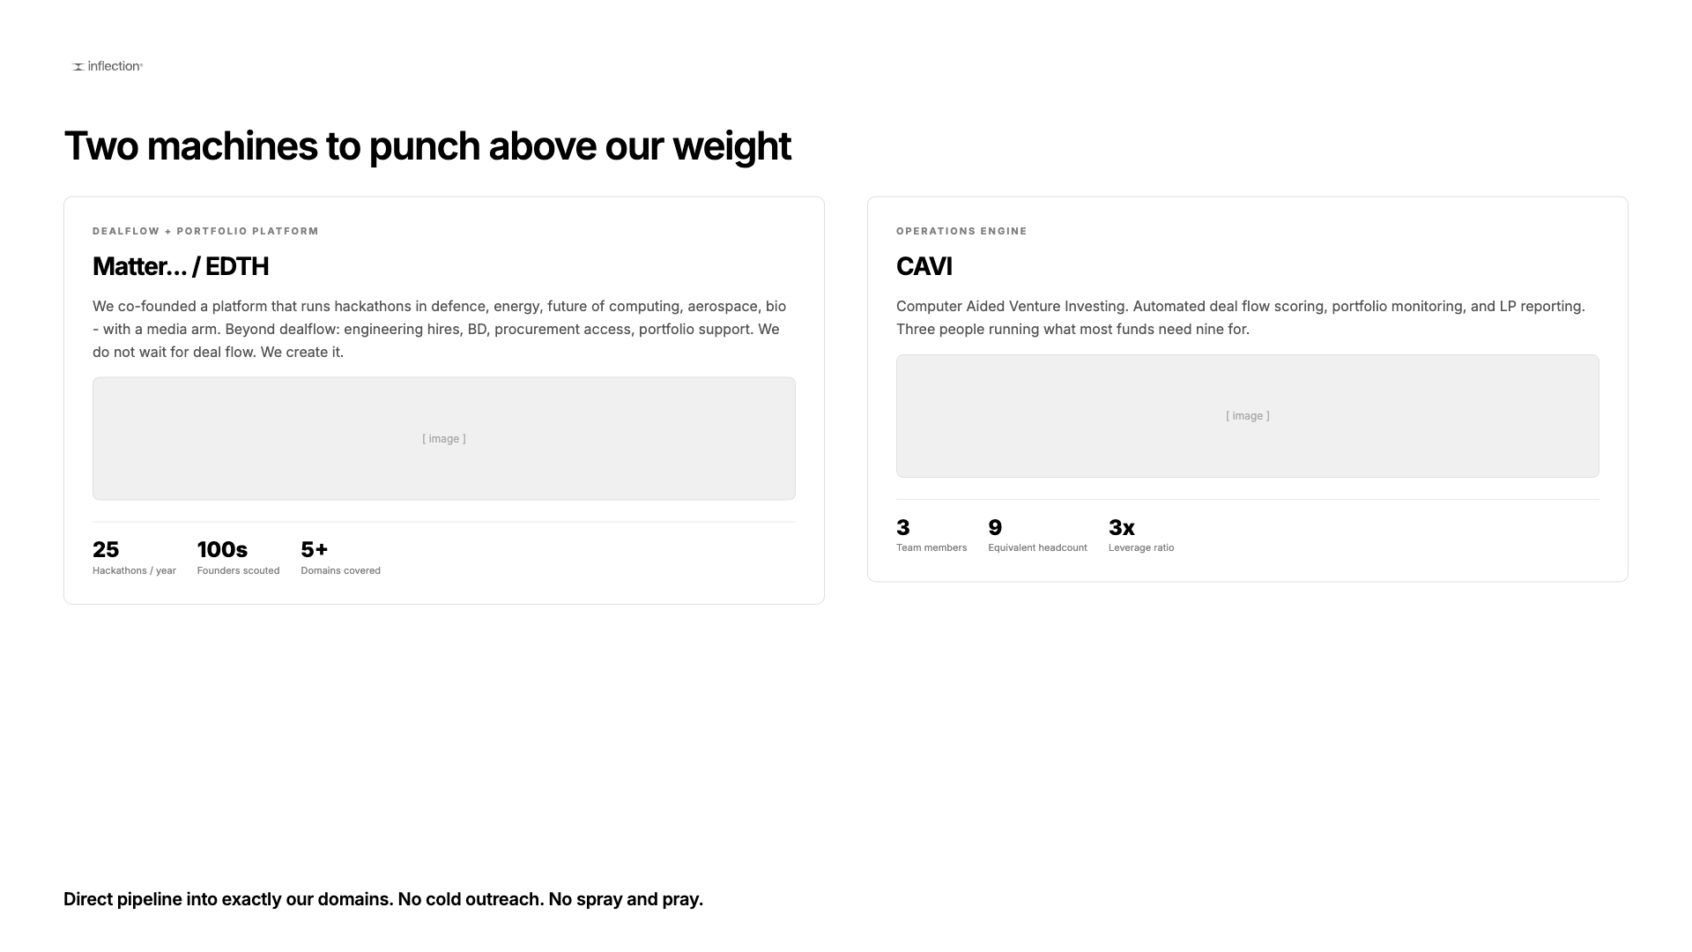
Two machines to punch above our weight
Notes:
Slide 10

Slide 12
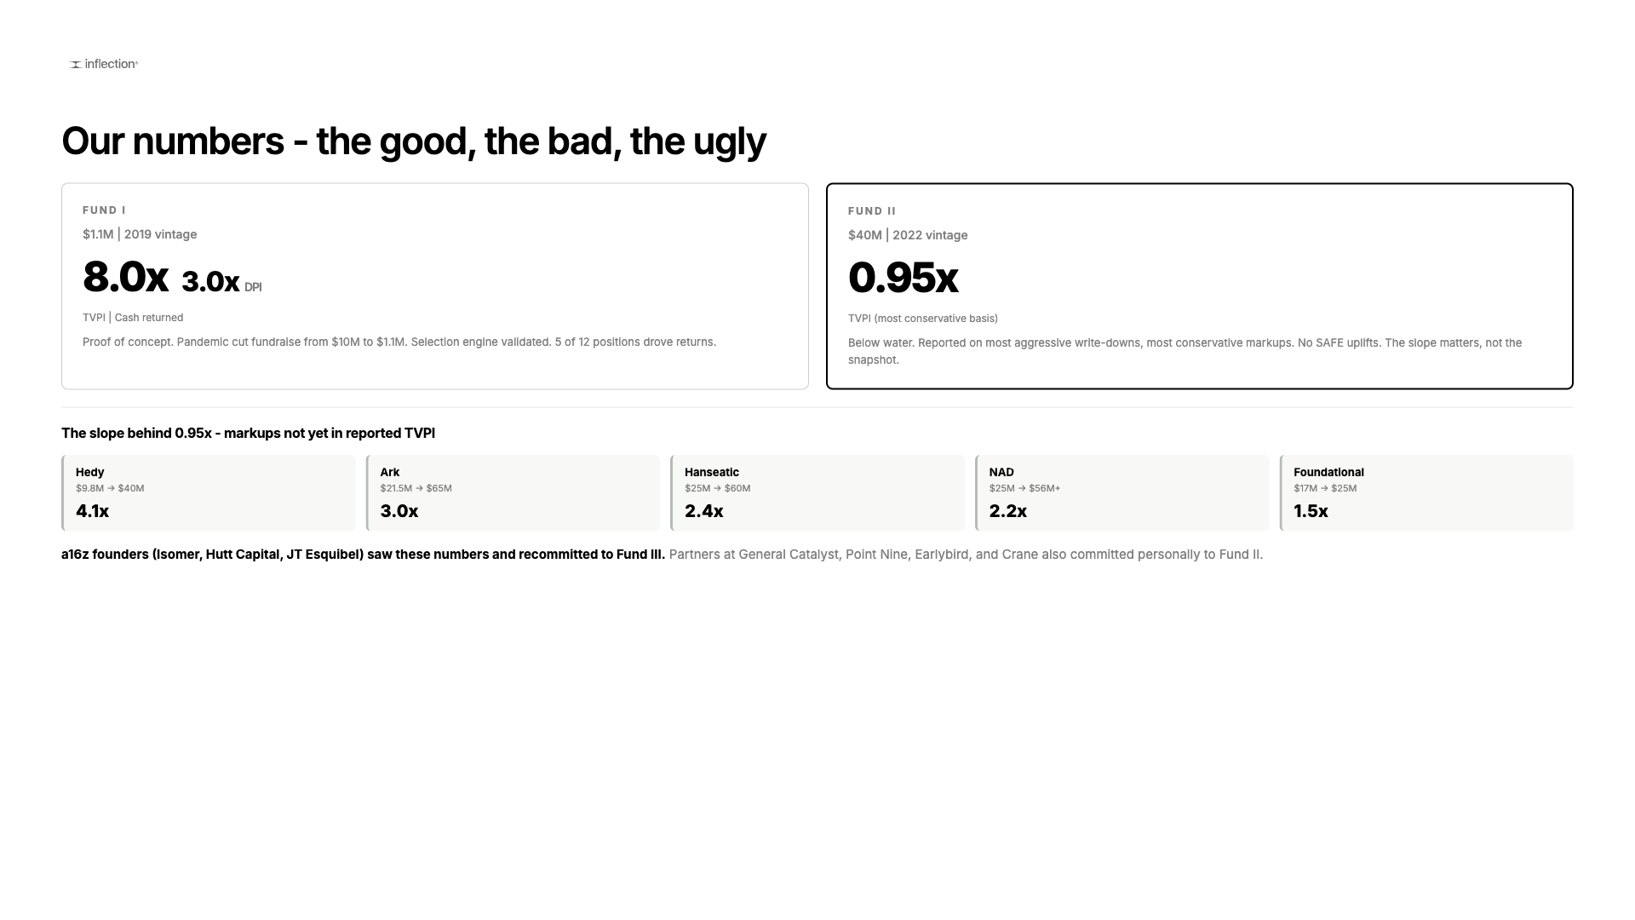
Our numbers - the good, the bad, the ugly
Notes:
Slide 11

Slide 13
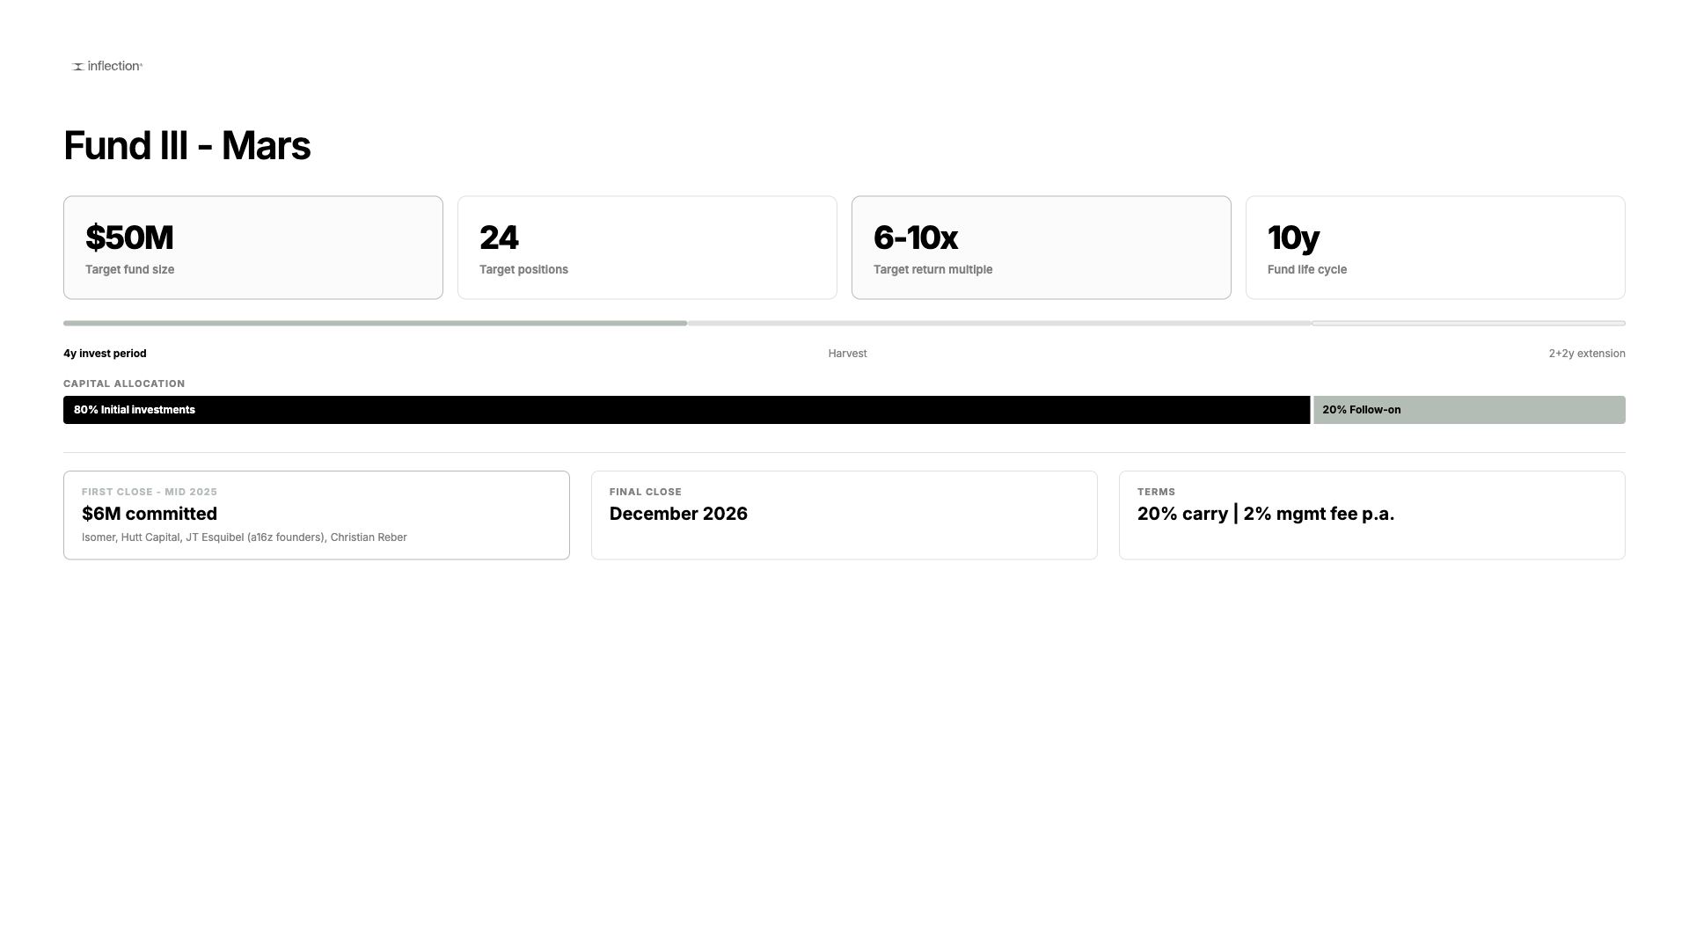
Fund III - Mars
Notes:
Slide 12

Slide 14
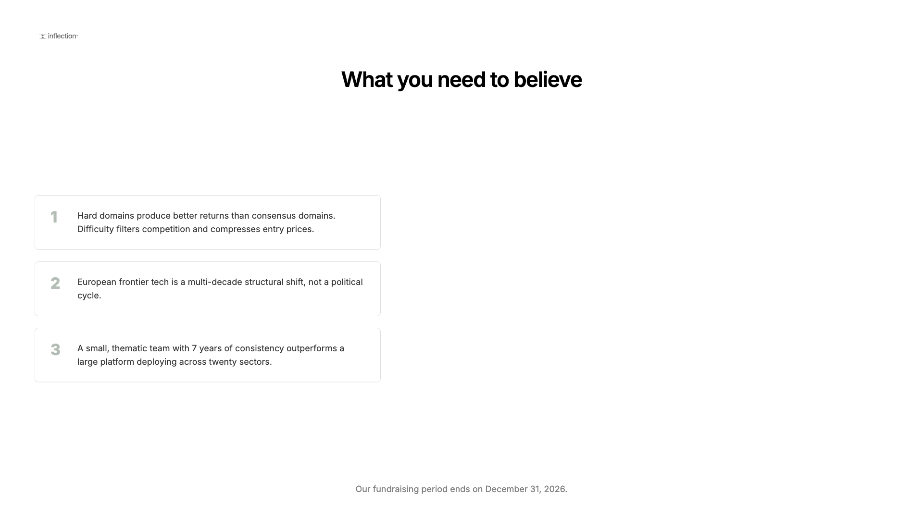
What you need to believe
Notes:
Slide 13

Slide 15
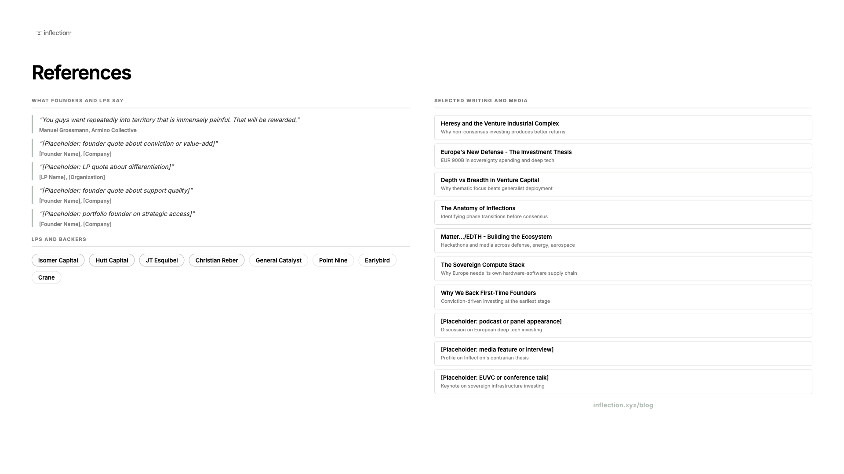
References
Notes:
Slide 14

Slide 16
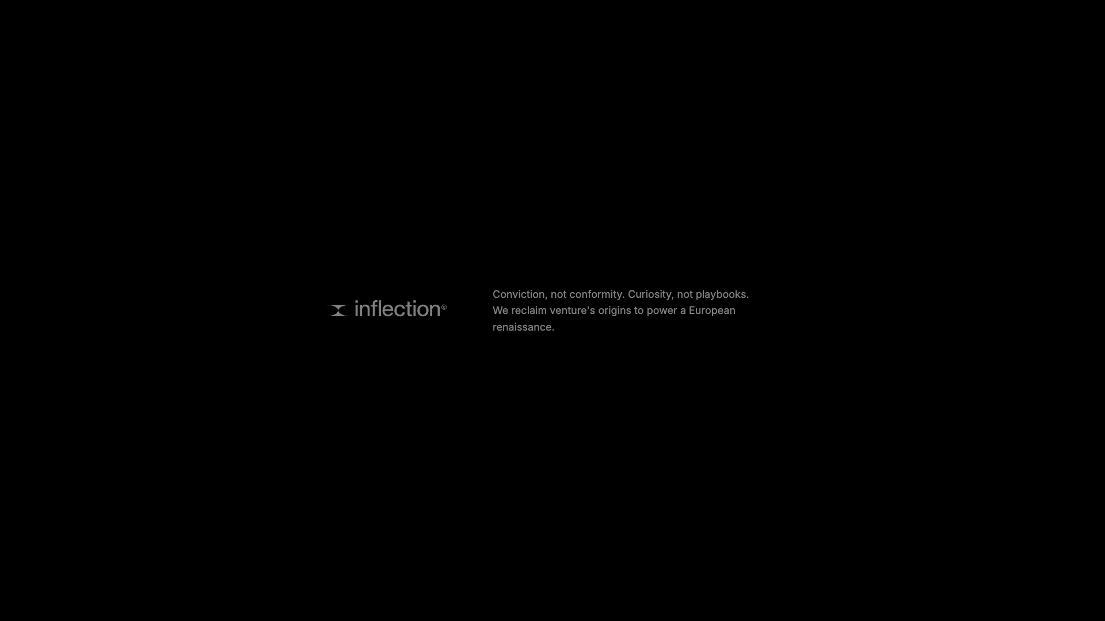
Notes:
Slide 15

